Slide 1
Fitness Cap
Tasmiyah Patni-19302A0055
Alfiya Iraqui-19302A0054

Slide 2

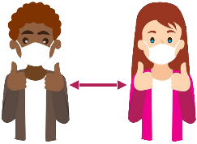




Problem Statement
People want to monitor each and every health aspect due to Covid
Social distance is very important, but people forget about it easily
Existing Devices are very expensive and unaffordable
There isn’t any ‘single’ device with all the required features
Predicting a possibility of Covid patient is also very important
We have designed a Cap with all the necessary features

Slide 3
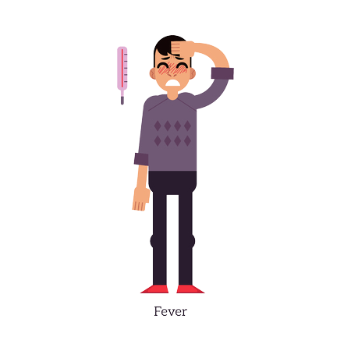
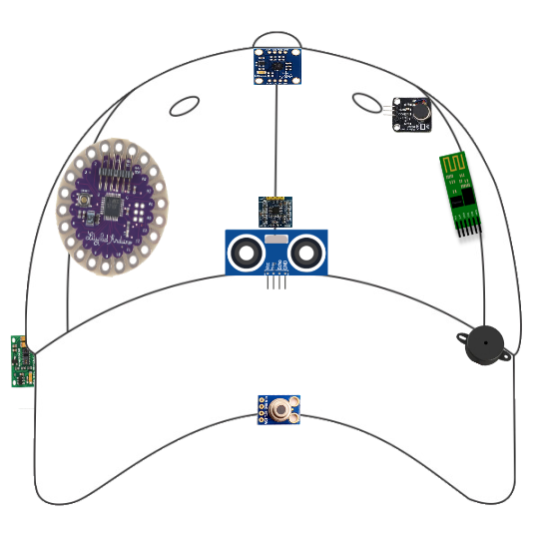
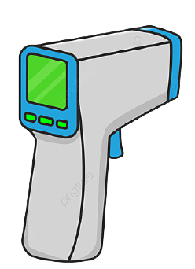
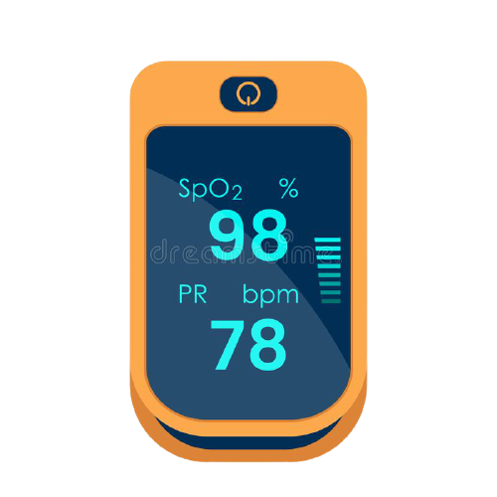
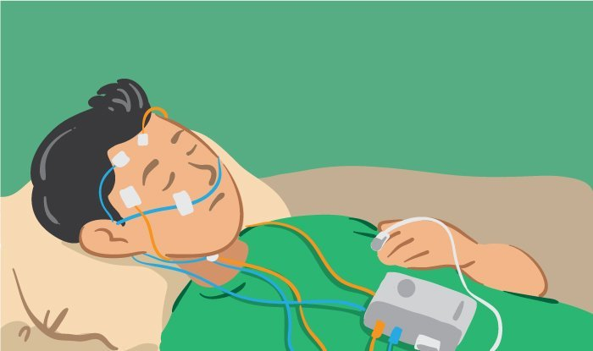
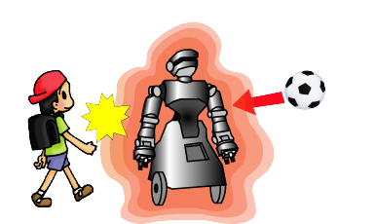
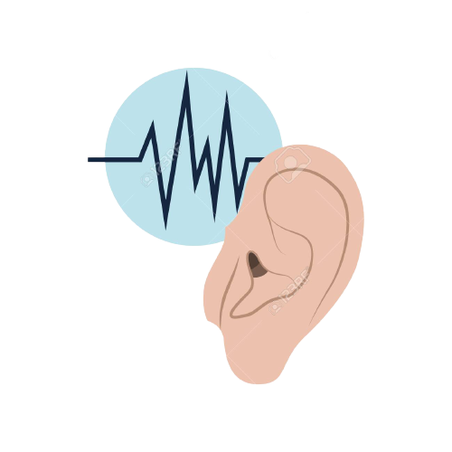
Project Working/Methodology
Vibrating
Disc (Inner)
Gyroscope
(Inner)
Bluetooth
Module (Inner)
Tempreture Sensor
IR Tempreture Sensor
Arduino Lilypad
Pulse and Oxymeter
Sensor
Pulse and Oxymeter
Sleep-Monitoring
Ultrasonic Sensor
Temperature
Sensor (Inner)
IR Temperature
Sensor
Buzzer
(Inner)
Proxymity Sensor
Buzzer Locator

Slide 4
Module-wise Functionality
Microcontroller: It processes and controls the flow of data that we receive from various modules
Distancing Module: It helps in maintaining safe distance from other humans
Self-Monitoring Module: It keeps tracks of various health aspects of the user like blood O₂ level, heart rate and body temperature
Contactless Thermometer Module: It helps in identifying a possible Covid patient
Sleep-Analysing Module: It analyses user’s sleep quality
Bluetooth Module: It displays the data and allows controls (eg: turning ON a locator buzzer) of the CAP on the smartphone

Slide 5
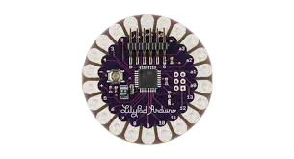

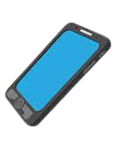
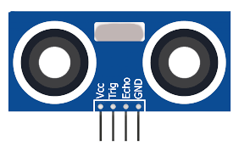
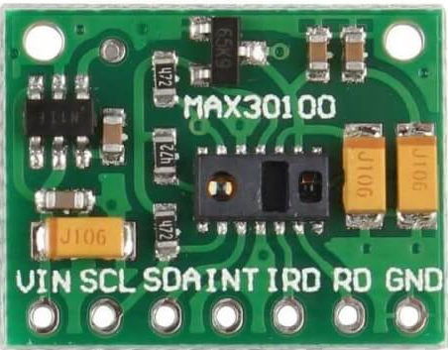
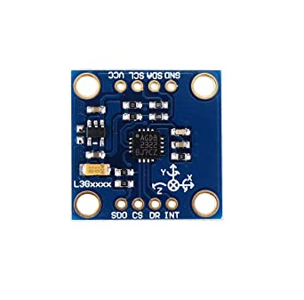
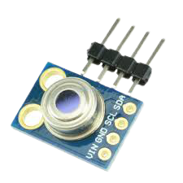
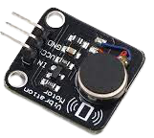

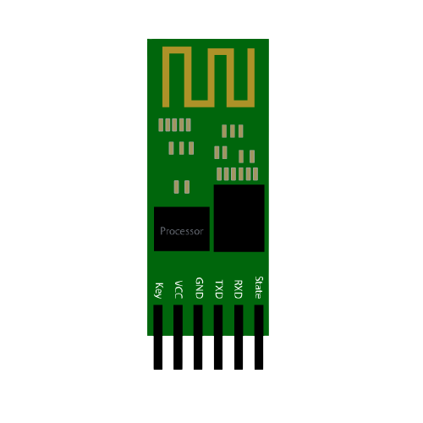
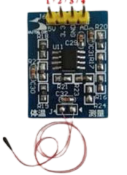
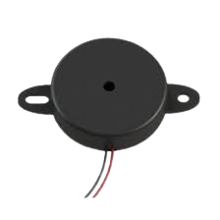
Hardware & Software to be USed
Oxymeter and
Heart Pulse Sensor
Battery
Ultrasonic Sensor
Smart-Phone
Arduino Lillypad
Hardware Used
Software and Languange
Gyroscope
IR-Temperature Sensor
Vibration Disc
Bluetooth Module
Temperature Sensor
Buzzer

